Slide 1
Containerization [ Docker (II)]

Slide 2
Agenda
Introduction to Docker Storage
Understanding Microservices
Introduction toDocker Compose
What are YAML files?
Introduction to Docker Swarm
Docker Networks

Slide 3
Introduction to Docker Storage

Slide 4


Introduction to Docker Storage
By default, all data of a container is stored on a writable container layer. This layer has the following properties:
Data only exists while the container is active. If the container no
longer exists, the data is also deleted along with the container.
The writable container layer is tightly coupled with the host machine; hence, it is not portable.
Data on the writable layer in the container is written using a storage driver.

Slide 5


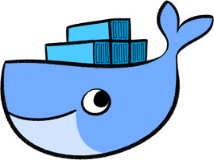



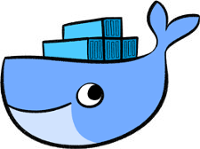
Introduction to Docker Storage
To persist data inside the container, even after it is deleted, we have two options:
Docker Volumes
Bind Mounts

Slide 6






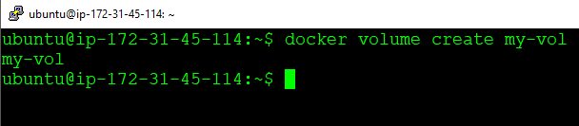


Types of Docker Storage
A Docker Volume is a mountable entity which can be used to store data in the docker filesystem.
Syntax
Docker Volumes
docker volume create my-vol
Bind Mounts

Slide 7



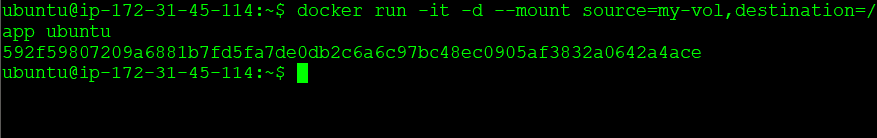
Types of Docker Storage
A Docker Volume is a mountable entity which can be used to store data in the docker filesystem.
Syntax
Docker Volumes
docker run -it --mount source=<source=folder>,destination=<destination-folder> -d
<container-name>
Bind Mounts

Slide 8



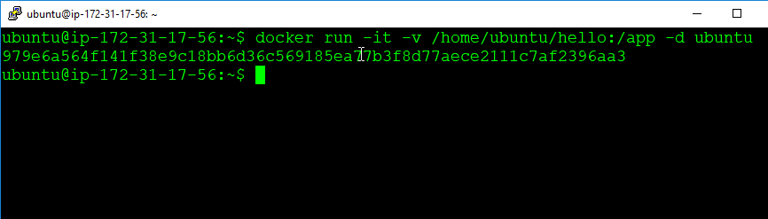
Types of Docker Storage
Bind Mounts mount a directory of the host machine to the docker container.
Syntax
docker run -it –v <source-directory>:<destination-directory>
-d <container-name>
Docker Volumes
Bind Mounts

Slide 9
Linking Docker Containers

Slide 10


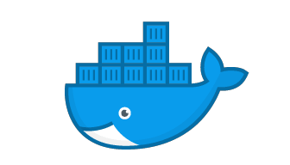

Linking Docker Containers
Linking is a legacy feature of Docker, which is used to connect multiple containers.
With linking, containers can communicate among each other. Name of containers is an important aspect while linking containers.
Once you link containers, they can reach out to others using their names.

Slide 11


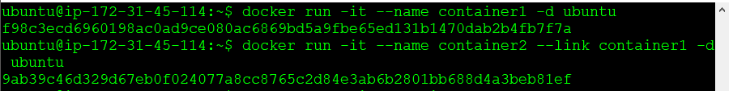
Linking Docker Containers
Syntax
docker run –it - -link <name-of-container> -d <image-name>

Slide 12
Hands-on: Linking Docker Containers

Slide 13


Hands-on: Linking Docker Containers
Create two containers of Ubuntu with names as follows: container1 and container2
Link container2 to container1
Try pinging from container2 to container1 by just using the command “ping container1”

Slide 14
Understanding Microservices

Slide 15







What is a Monolithic Application?
A Monolithic application is a single-tiered software application in which different components are combined into a single program which resides in a single platform.
Noti fications
Mail
Payments
Loca ti on
Services
Cus tomer Service
Passenger Management

Slide 16



Disadvantages of a Monolithic Application
Application is large and complex to understand.
Entire application has to be re-deployed on an application update.
Bug, in any module, can bring down the entire application.
It has a barrier to adopting new technologies.

Slide 17








What are Microservices?
Microservices are a software development architectural style that structures an application as a collection of loosely coupled services.
Mail
Noti fications
Payments
Loca ti on Services
Cus tomer
Service
Passenger Management

Slide 18


What are Microservices?
Microservices are a software development architectural style that structures an application as a collection of loosely coupled services.
Mail
Noti fications
Payments
Loca ti on Services
Cus tomer
Service
Passenger Management

Slide 19



Advantages of Microservices
Application is distributed, hence easy to understand.
The code of only the Microservice which is supposed to be updated is changed.
Bug, in one service, does not affect other services.
There is no barrier to any specific technology.

Slide 20
Introduction to Docker Compose

Slide 21

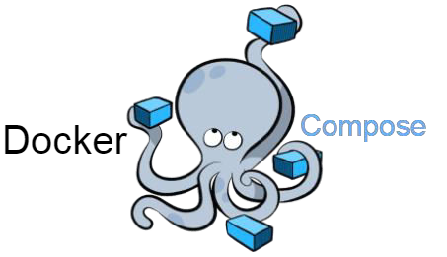
What is Docker Compose?
Compose is a tool for defining and running multi-container Docker applications. With Compose, you use a YAML file to configure your application's services. Then, with a single command, you create and start all the services from your configuration. Run docker-compose up
and compose starts and runs your entire app.

Slide 22
Installing Docker Compose

Slide 23

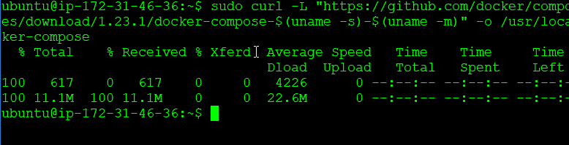
Installing Docker Compose
1. First, download the Docker Compose file using the following command:
sudo curl -L "https://github.com/docker/compose/releases/download/1.24.1/docker-compose-
$(uname -s)-$(uname -m)" -o /usr/local/bin/docker-compose

Slide 24

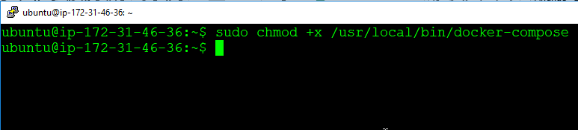
Installing Docker Compose
2. Now, give the required permission to the Docker Compose file to make it executable:
sudo chmod +x /usr/local/bin/docker-compose

Slide 25


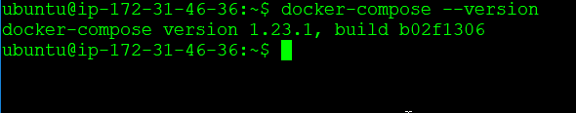
Installing Docker Compose
3. Finally, verify your installation using the following command:
docker-compose --version

Slide 26

What is Docker Compose?
For deploying containers using Docker Compose, we use YAML files.

Slide 27
What are YAML files?

Slide 28

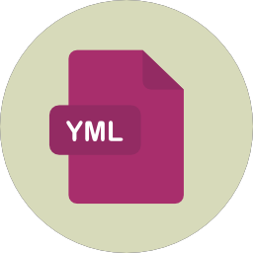
What are YAML files?
YAML is a superset of a JSON file. There are only two types of structures in YAML which you need to know to get started:
Maps
Lists

Slide 29








What are YAML files?
When we map a key to a value in YAML files, they are termed as Maps.
Maps
<key> : <value>
Lists
For example:
Name: Training Course: Devops

Slide 30






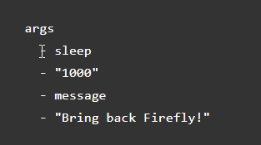
What are YAML files?
YAML Lists are a sequence of objects.
Maps
Args
arg 1
arg 2
arg 3
Lists
For example:

Slide 31
Writing a Docker Compose File

Slide 32

Writing a Docker Compose File
version: '3'
services:
sample1:
image: httpd ports:
- “80:80"
sample2:
image: nginx
Sample Docker Compose File

Slide 33
Hands-on: Running a Sample Docker Compose File

Slide 34

Hands-on: Sample Docker Compose File
Create a folder called “docker”
Write the sample YAML file in “docker-compose.yml” file
To build this docker-compose file, the syntax is as follows:
docker-compose up -d
Ensure that all your containers are running

Slide 35
Hands-on: Deploying WordPress

Slide 36
Hands-on: Deploying WordPress
version: '3.3'
services:
db:
image: mysql:5.7 volumes:
db_data:/var/lib/mysql restart: always environment:
MYSQL_ROOT_PASSWORD: somewordpress MYSQL_DATABASE: wordpress MYSQL_USER: wordpress MYSQL_PASSWORD: wordpress
wordpress:
depends_on:
db
image: wordpress:latest ports:
- "8000:80"
restart: always
environment: WORDPRESS_DB_HOST: db:3306
WORDPRESS_DB_USER: wordpress WORDPRESS_DB_PASSWORD: wordpress
volumes: db_data:
docker-compose.yaml

Slide 37
Hands-on: Deploying WordPress
Create a folder called “docker-wordpress”
Write the sample YAML file in “docker-compose.yml” file
To build this docker-compose file, the syntax is as follows:
docker-compose up -d
Ensure that all your containers are running

Slide 38
What is Container Orchestration?

Slide 39

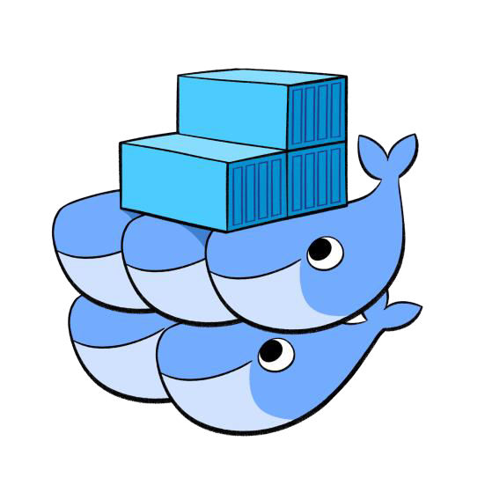
What is Container Orchestration?
Applications are typically made up of individually containerized components (often called microservices) that must be organized at the networking level in order for the application to run as intended. The process of organizing multiple containers in this manner is known as container orchestration.

Slide 40
Introduction to Docker Swarm

Slide 41

What is Docker Swarm?
Docker Swarmis a clustering and scheduling tool for Docker containers. With Swarm, IT administrators and developers can establish and manage a cluster of Docker nodes as a single virtual system.

Slide 42
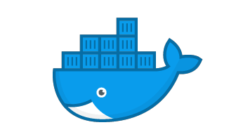




What is Docker Swarm?
Worker 1
Worker 2
Worker 3
Leader

Slide 43
Creating a Docker Swarm Cluster

Slide 44
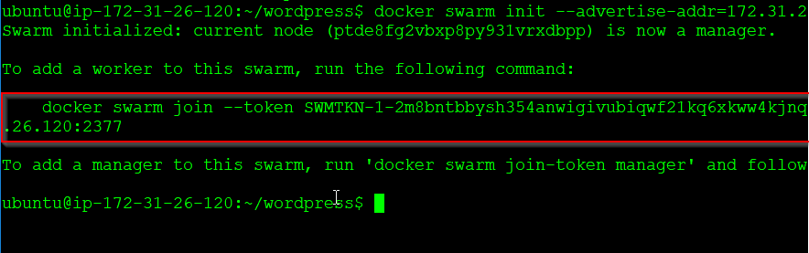
Creating a Docker Swarm Cluster
docker swarm init --advertise-addr=<ip-address-of-leader>
This command should be passed on to the worker node to join the docker swarm cluster.

Slide 45
Introduction to Services

Slide 46











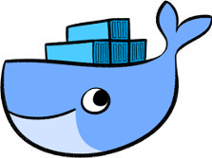
What is a Service?
Containers on the cluster are deployed using services on Docker Swarm. A service is a long- running Docker container that can be deployed to any node worker.
Service

Slide 47

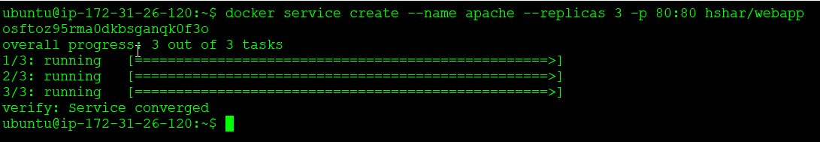
Creating a Service
docker service create --name <name-of-service> --replicas <number-of-replicas> <image-name>

Slide 48
Hands-on: Creating a Service in Docker Swarm

Slide 49



Hands-on: Creating a Service in Docker Swarm
Create a Service for nginx webserver
There should be 3 replicas of this service running on the swarm cluster
Try accessing the service from Master IP and Slave IP
Service

Slide 50
Docker Networks

Slide 51




Why Docker Networks?
Let’s take an example. Say, there are two containers which we deploy in the docker ecosystem.
Website Container
Database Container

Slide 52

Why Docker Networks?
By default, these containers cannot communicate with each other.
Website Container
Database Container

Slide 53


Why Docker Networks?
Therefore, in-order to have interactions between Docker Containers, we need Docker Networks.
Website Container
Database Container
Docker Network

Slide 54

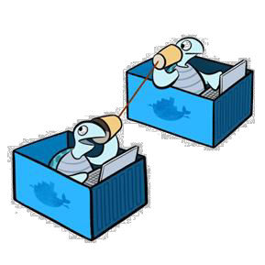
What are Docker Networks?
One of the reasons Docker containers and services are so powerful is that you can connect them together or connect them to non-Docker workloads. And, this can be accomplished using Docker Networks.

Slide 55





Docker Network Types
Docker Networks are of the following types:
bridge
host
overlay
macvlan
none

Slide 56








Docker Network Types
bridge
Bridge Networks
host
The default network driver. If you don’t specify a driver, this is the type of network you are creating. Bridge networks are usually used when your applications run in standalone containers that need to communicate.
overlay
macvlan
none

Slide 57

Docker Network Types
bridge
Host Networks
host
For standalone containers, remove network isolation between the container and the Docker host and use the host’s networking directly. Host is only available for swarm services on Docker 17.06 and higher.
overlay
macvlan
none

Slide 58

Docker Network Types
bridge
Overlay Networks
host
Overlay networks connect multiple Docker daemons together and enable swarm services to communicate with each other. You can also use overlay networks to facilitate communication between a swarm service and a standalone container or between two standalone containers on different Docker daemons.
overlay
macvlan
none

Slide 59


Docker Network Types
bridge
Macvlan Networks
host
Macvlan networks allow you to assign a MAC address to a container, making it appear as a physical device on your network. The Docker daemon routes traffic to containers by their MAC addresses.
overlay
macvlan
none

Slide 60

Docker Network Types
bridge
None
host
For this container, disable all networking. This is usually used in conjunction with a custom network driver. And, none is not available for swarm services.
overlay
macvlan
none

Slide 61
Hands-on: Deploying a Multi-tier App in Docker Swarm

Slide 62

Hands-on: Multi-tier App in Docker Swarm
Create an overlay network named “my-overlay”
Deploy a website container in the overlay network
Image: hshar/webapp
Deploy a database container in the overlay network
image: hshar/mysql:5.6
username: root password: <password>
Make changes in the website code to point to MySQL service
Test the configuration by entering values in the website

Slide 63
Got queries or need more info?
Contact us
T O A C C E L E R A T E Y O U R C A R E E R G R O W T H
For questions and more details:
please call @ +91 98712 72900 or
visit https://www.thecloudtrain.com/ or
email at join@thecloudtrain.com or
WhatsApp us >>

